Slide 1
Monster Hunter
Ryan Sprowles

Slide 2
What is Monster Hunter?
It’s a game where you die a lot.

Slide 3
Seriously?
YES!
Also you kill monsters to harvest them to make more weapons to kill more monsters

Slide 4
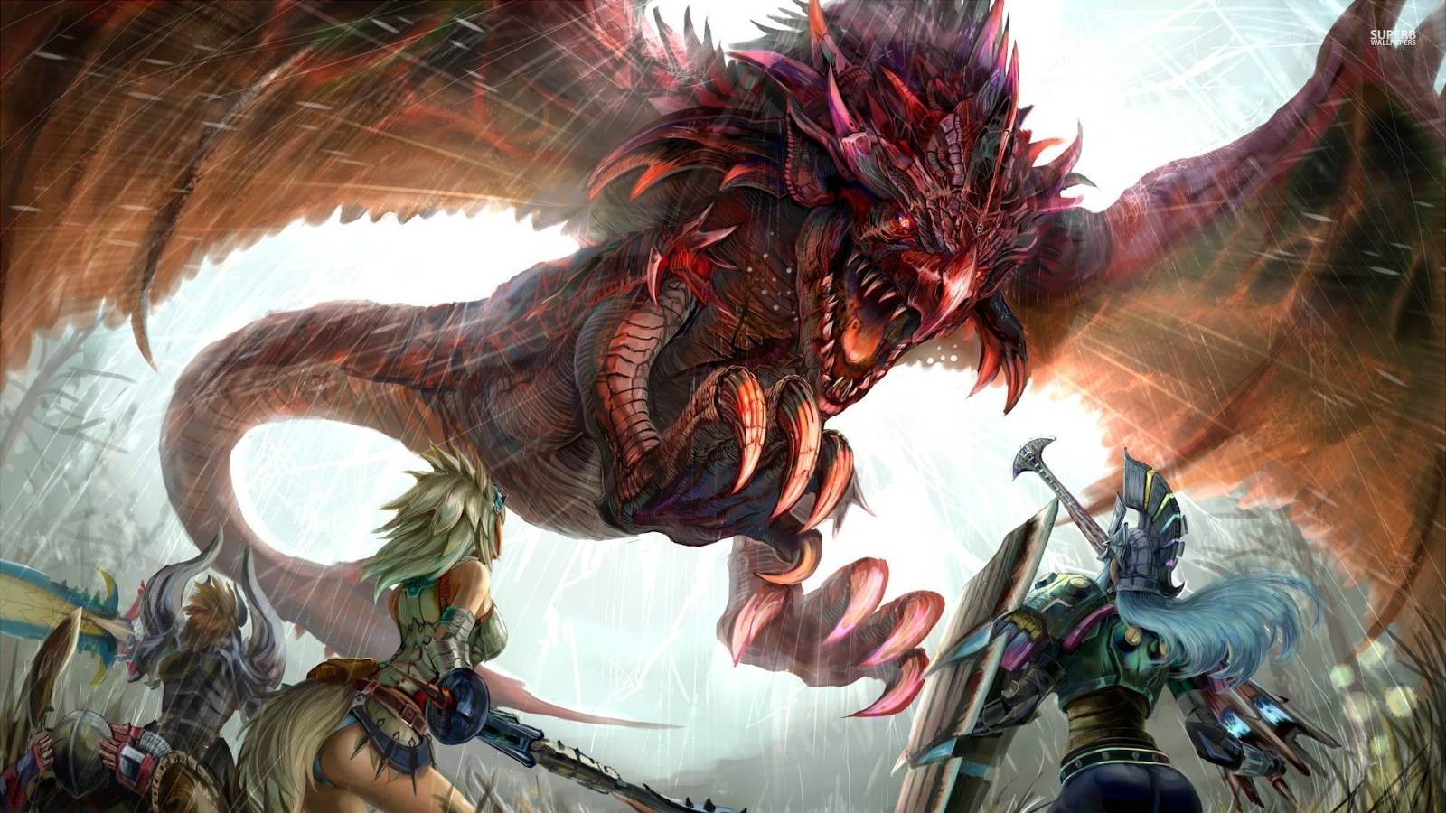
Example

Slide 5
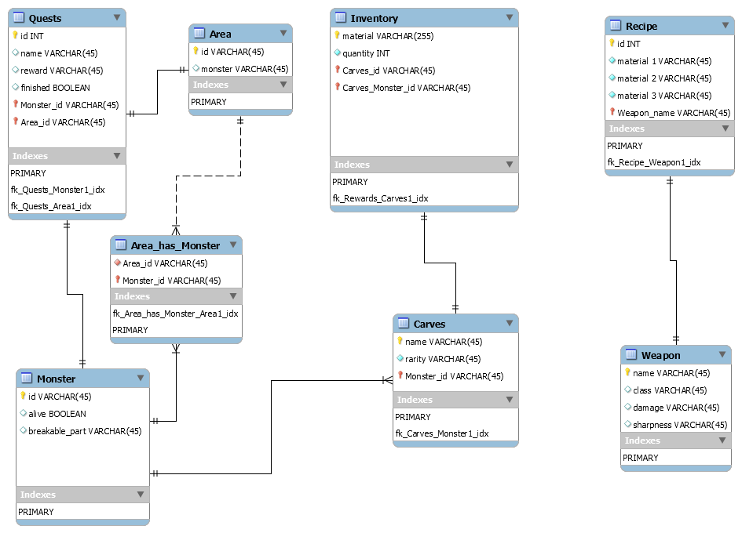

Slide 6
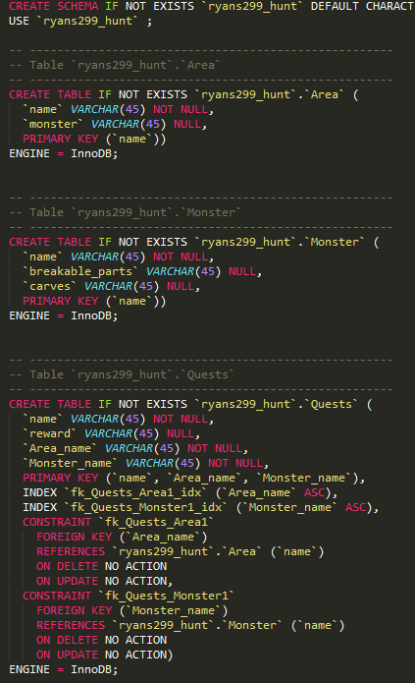
Table DDL

Slide 7
Isolation Level
Repeatable Read
It’s the default and this database likely won’t see too much traffic

Slide 8
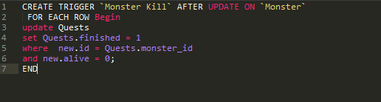
Trigger

Slide 9
Integrity Enforcement
Primarily based on the use of foreign keys

Slide 10
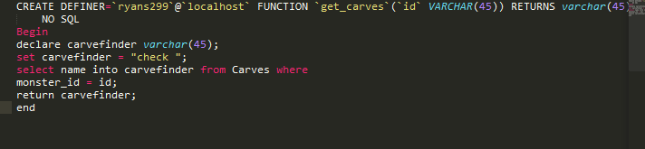
Function
Gets a Carve from the killed monster

Slide 11
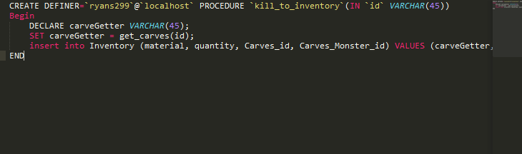
Procedure
Adds an Item to the inventory, only way to add to it

Slide 12
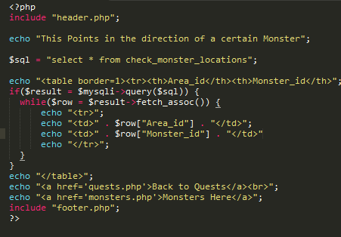
View
Allows to see just the area and monster

Slide 13
Normalization
Everything is in third normal form, foreign keys enforce key and non-key attribute distinction

Slide 14
Demo
http://ryans2.siteground.net/welcome.html

